Slide 1
EtherCAT Tools
Overview
Network Configuration Tools
Network Monitoring and Debugging Tools
EtherCAT Utility Tools for Winmax
Vendor Tools

Slide 2
Network Configuration Tools
EtherCAT Configurator – BeckHoff ET9000
A tool for configuring EtherCAT network and generating an ENI file. It can also work as master under Windows. BeckHoff has stopped supporting it.
Located at the TFS folder:
\projects\Third Party Libraries\EtherCAT\ET9000
BeckHoff TwinCAT
BeckHoff master software. It can also configure EtherCAT network and generate an ENI file.
A trial version is free.

Slide 3
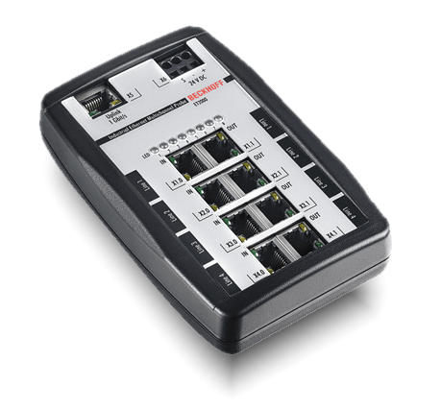
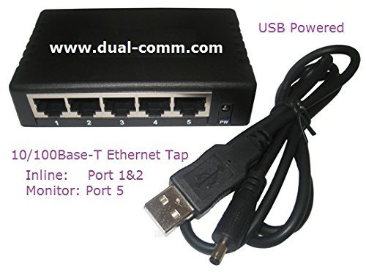
Network Monitoring and Debugging Tools - Hardware
Beckhoff ET2000 – Ethernet Multi-Channel Probe.
High timestamp resolution of 1 ns and low cycle delay of < 1us. A powerful device for diagnosing DC clock and real time data issues.
http://infosys.beckhoff.com/english.php?content=../content/1033/et2000/1309649803.html&id=
Dualcomm DCSW-1005
USB powered 5-port 10/100 fast Ethernet switch Tap for monitoring network data. A great device for debugging real time data issues.

Slide 4
Network Monitoring and Debugging Tools - Software
Wireshark -- Network Protocol Analyzer
Works with both BechHoff ET9000 and Dualcomm DCSW-1005 devices.
Supports EtherCAT protocol including CoE, SoE and FoE.
A handy software for analyzing and debugging EtherCAT real time data issues.
It is free and can be downloaded from https://www.wireshark.org/

Slide 5
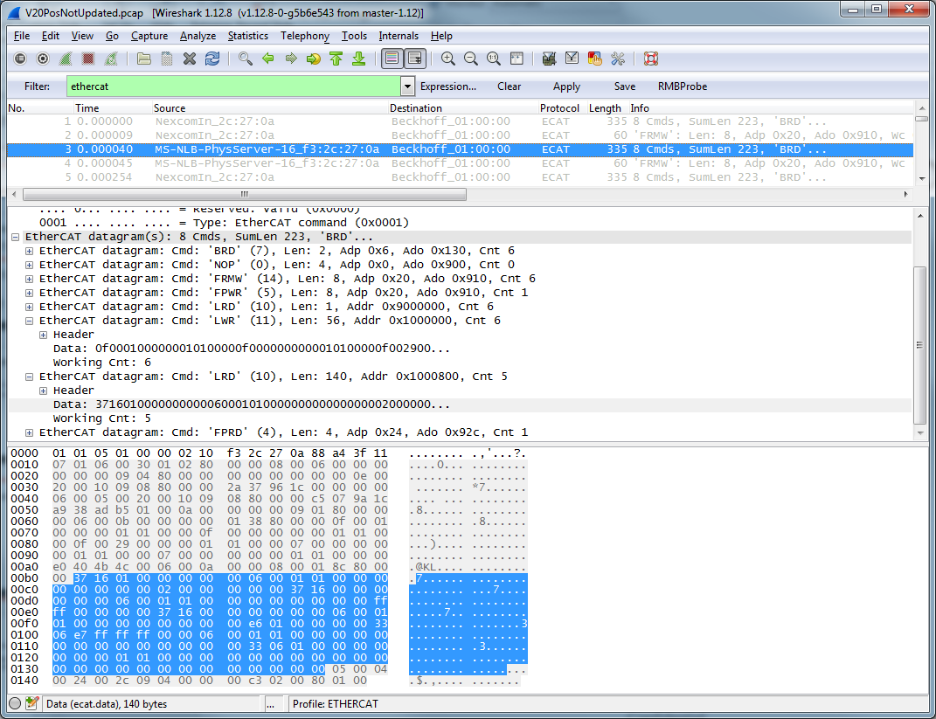
WireShark

Slide 6
EtherCAT Utility Tools for Winmax
EcatFoETool
EniBuilder
EniTester

Slide 7
EcatFoETool
A standalone tool “EcatFoeTool.rtss” under RTX for flashing firmware via FoE. Built with the EtherCAT library “EtherCAT.lib”.
The file “EcatFoEFirmCfg.xml” contains EtherCAT network settings and expected firmware version of each supported device (SGDV, SD and HAL RMB). The tool doesn’t support Rexorth IndraDrive at this time.
Winmax launches the tool to check and perform firmware flashing during Winmax startup. Firmware flashing always starts from the last connected device.
Located at the TFS folder:
RTX2012
\projects\Hurco Projects\Development\Utility\EcatFoETool\MT\RTSS
RTX8/RTX2011
\projects\Hurco Projects\Development\Utility\EcatFoETool\RTSS

Slide 8
EniBuilder
An utility tool can automatically create an ENI file based on connected EtherCAT devices.
EniBuilder has two running modes: GUI and Non-GUI.
Each supported EtherCAT device has a template xml file and this template file contains PDO settings, DC clock configuration, etc. Master also has its own template xml file. EniBuilder creates an ENI file based on these templates and bus scan result.
In order to scan EtherCAT bus and collect connected EtherCAT devices information under RTX, another standalone tool “EcatScanBus.rtss” was developed.
The configuration file “EniBuilder.Cfg” contains EtherCAT network settings.
During its startup, Winmax calls a batch file to run EniBuilder. The batch file first runs “EcatScanBus.rtss” to scan the bus. A text file “EcatSlaves.txt” will be written after bus scan completes. Then the batch file launches EniBuilder in non-GUI mode to create an ENI file based on the bus scan result file “EcatSlaves.txt”.

Slide 9
EniTester
A lightweight standalone tool “EniTester.rtss” under RTX to quickly test EtherCAT communication, DC and selected ENI file. It is also used as a testing tool to check released master stack before upgrading BBQ.
Built with the EtherCAT library.
The configuration file “EniTesterCfg.xml” contains EtherCAT network settings and devices configuration.

Slide 10
Vendor Tools
Yaskawa
SigmaWin+ for SGDV.
SigmaWin for SD.
Rexroth
IndraWorks DS for IndraDrive.

Slide 11
Resources
Yaskawa SGDV/SD
https://www.yaskawa.com/pycprd/products/sigma5-servo-products/servopacks/sgdv-ethercat
Rexroth IndraDrive
http://www.boschrexroth.com/dcc/Vornavigation/Vornavi.cfm?Language=EN&VHist=g97568,g96067&PageID=p146994
ETG
www.ethercat.org

